Slide 1
Guarded Suspension
Yunus Koçyiğit

Slide 2
What is a Design Patterns
A pattern is a reusable solution to a recurring problem.
Design Patterns are about Object Oriented Design.
Patterns can be about other topics
(Analysis, Coding, Testing,..)

Slide 3
Structure of Patterns
Synopsis
Context(Problem Statement)
Forces
Solution
Consequences
Related Pattern

Slide 4
Guarded Suspension:
Synopsis
If a condition exists that prevents a method from doing what it is supposed to do, suspend execution of the method until the condition no longer exists.

Slide 5
Guarded Suspension: Context 1
You have to design a class that implements a queue data structure
Queue
isEmpty():boolean
push(:Object) {concurrency=guarded}
pull( ):Object {concurrency=guarded}

Slide 6
Guarded Suspension: Context 2
The push method adds objects to a queue.
The pull method removes objects.
If pull is called when the queue is empty, it
doesn’t return until there is an object in the queue.An object can be added to queue while the pull method is waiting is another thread calls the push method

Slide 7
Guarded Suspension: Context 3
The push and pull methods are both synchronized to allow multiple threads to safely make concurrent calls
Because they are synchronized, calls to push cannot execute until the pull method returns.When the queue is empty
, the pull method never returns until a call to push method executes.

Slide 8
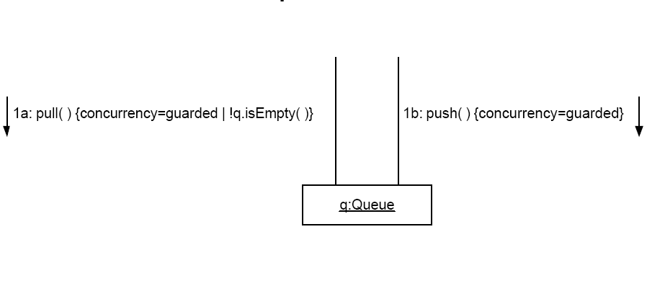
Guarded Suspension: Context 4

Slide 9
Guarded Suspension: Forces1
A class’s methods must be synchronized to allow safe concurrent calls.

Slide 10
Guarded Suspension: Forces 2
An object’s state may prevent of its synchronized methods completing properly.To leave the state, one of the object’s other synchronized methods must execute.If a call the first method is allowed to proceed while the object is in that state, it deadlocks and never completes.

Slide 11
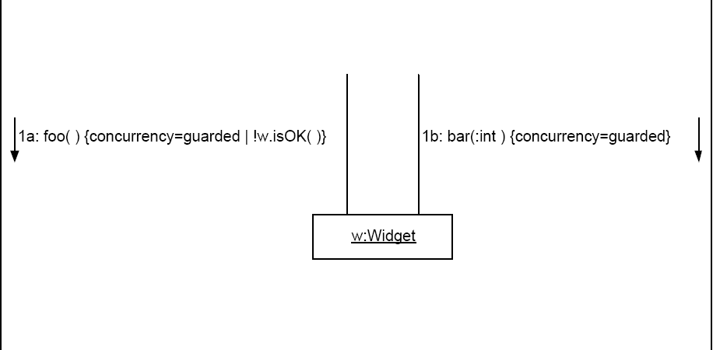
Guarded Suspension: Solution

Slide 12
Guarded Suspension: implementation 1
İmplement Guarded Suspension using wait and notify
Class Widget{
synchronized void foo(){
while(!isOK()){
wait();
}
…
}
Synchronized void bar(int x) {
…
Notify();
}
}

Slide 13
Guarded Suspension:
Implementation 2
An alternative when arbitary selection is not a good way to decide which thread to notify is the notifyAll method. The notifyAll method notifies all waiting threads. This avoids the problem of not notifying the right thread
Machine cycles may be wasted as a result of waking up threads waiting up threads waiting to execute method calls whose preconditions are not satisfies

Slide 14
Guarded Suspension:
Consequences 1
The Guarded Suspension pattern allows a thread to cope with an object unable to perform an operation by waiting until the object is able to perform the operation.

Slide 15
Guarded Suspension:
Consequences 2
Multiple threads may be waiting to execute calls to the same method.The Guarded Suspension pattern specially does not deal with selecting which waiting thread will be allowed to proceed when the method to be executed. Use the Scheduler pattern for this purpose

Slide 16
Guarded Suspension:
Consequences 3
The guarded suspension pattern may not work when guarded methods are called from synchronized methods.

Slide 17
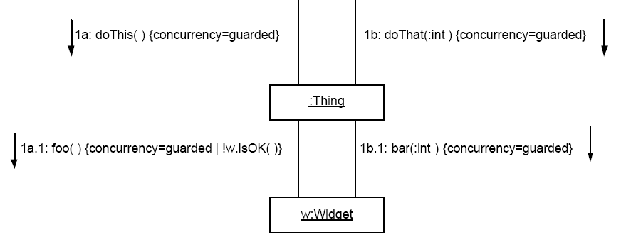
Guarded Suspension:
Consequences 3

Slide 18
Guarded Suspension:
Related Patterns
Balking is a different way to handle method calls at inopportune times
Implementation of Two-Phase Termination involves throwing and handling InterruptedExecution; it interacts with the Guarded Suspension pattern

Slide 19
References
Kuchana, Partha (2004), Software Architecture Design Patterns in Java, Boca Raton, Florida: Auerbach Publications
Douglas C. Schmidt, Michael Stal, Hans Rohnert, Frank Buschmann "Pattern-Oriented Software Architecture, Volume 2, Patterns for Concurrent and Networked Objects", Wiley, 2000
Patterns in Java, Volume 1,By Mark Grand

